Slide 1
A Sustainable and
Progressive Future:
Cyano Technologies
Stephanie Conley
CSE 237D

Slide 2
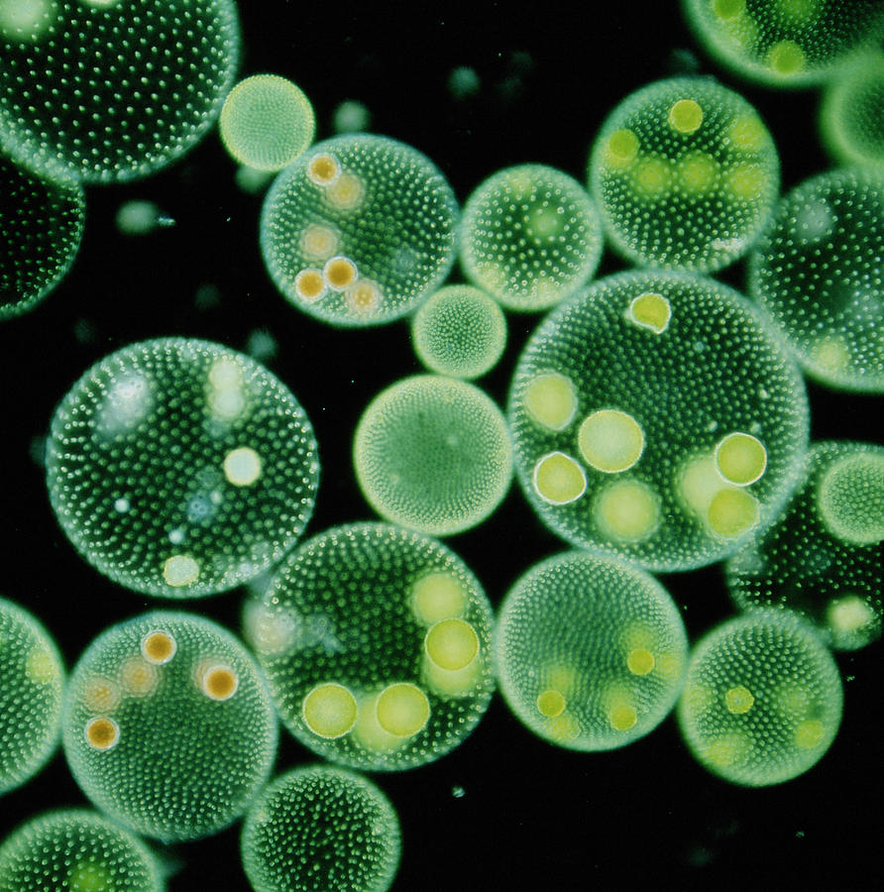
Volvox

Slide 3
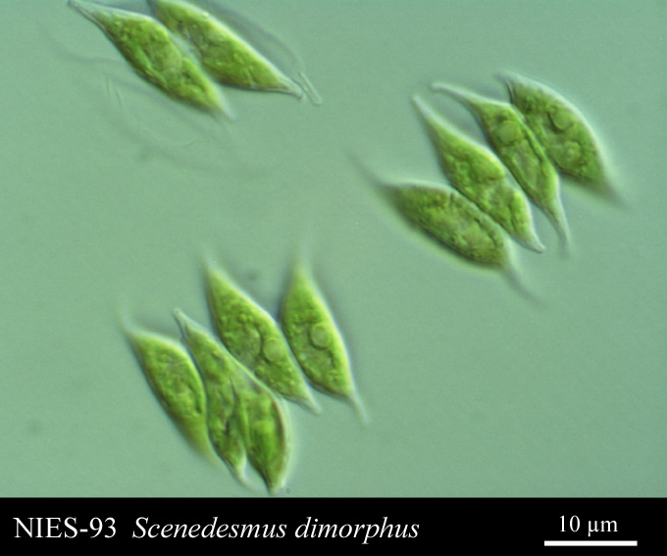

Slide 4
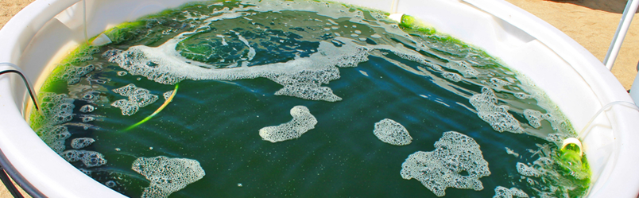
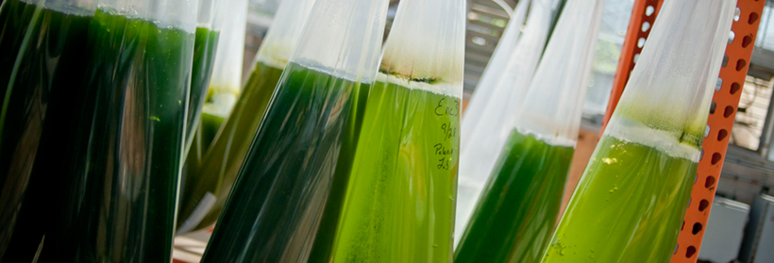
California Center for Algae Biotechnology (Cal-CAB)

Slide 5
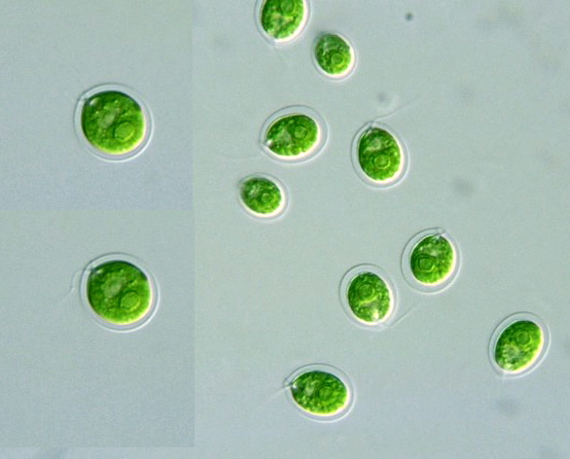
C. reinhartii

Slide 6

Scalable
Not Geographic
Dependent
Carbon Neutral
Fast Growing
Renewable
Sustainable

Slide 7
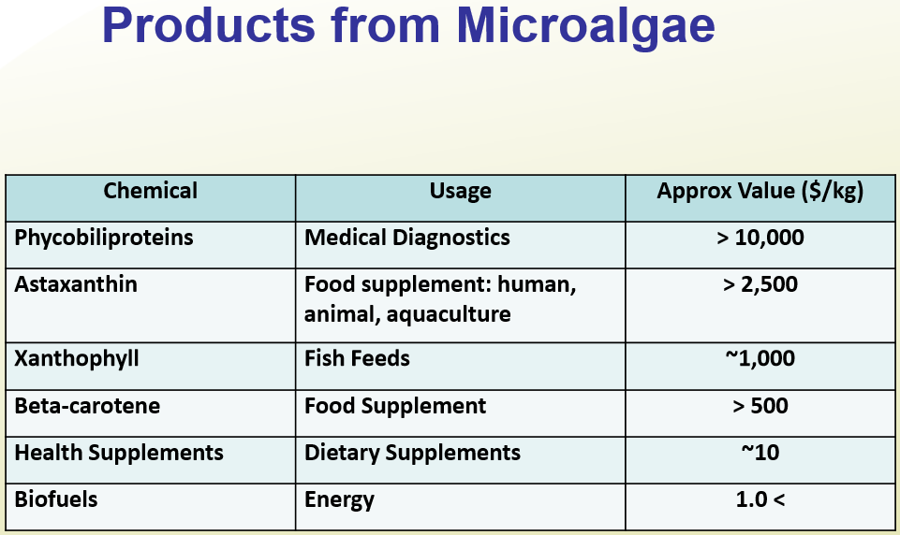
Source: Utah State University, http://www.nrel.gov/biomass/pdfs/zemke.pdf

Slide 8
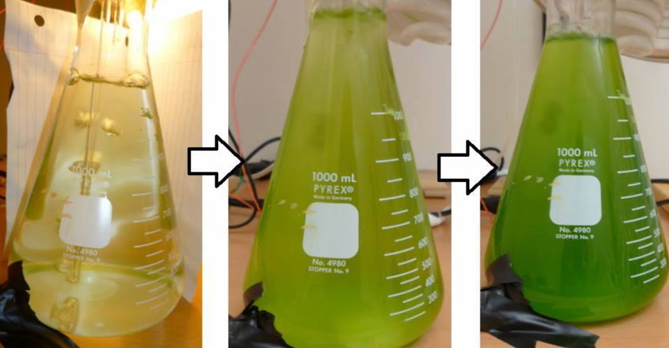
CyanoStat: Two Weeks
Day 1
Day 8
Day 14

Slide 9
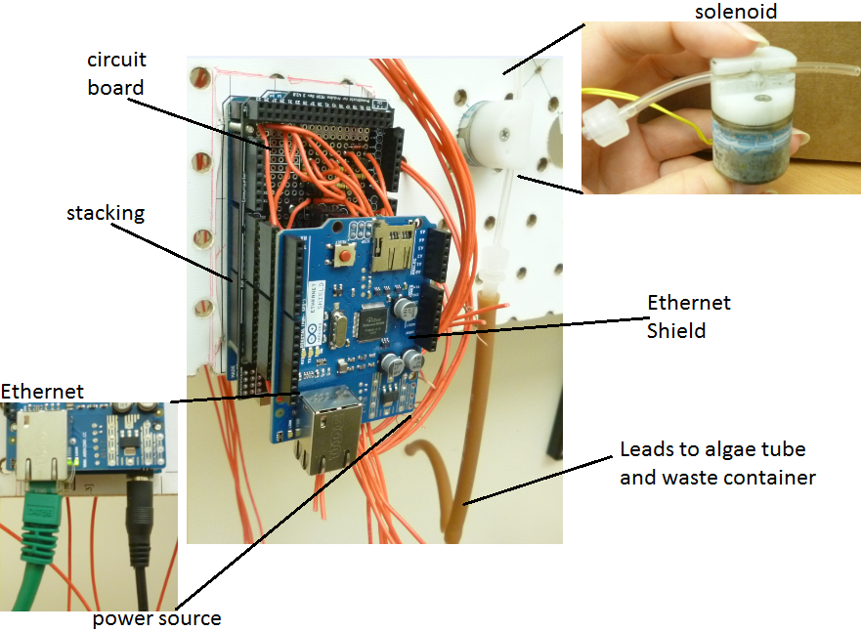
CyanoStat

Slide 10
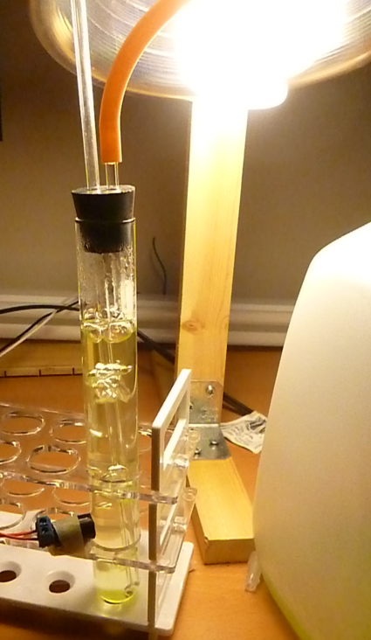
Light source
Air/nutrients
Waste outlet
Photoresistor

Slide 11
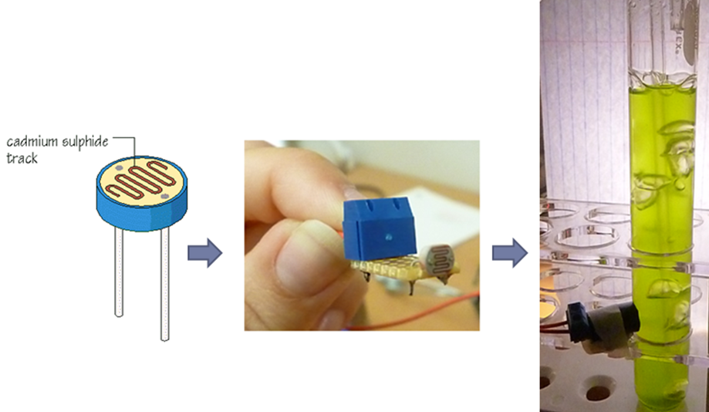
Photoresistors

Slide 12
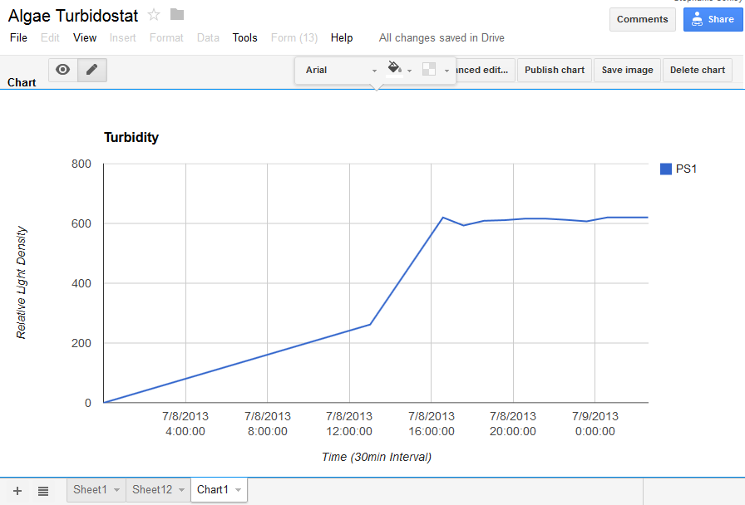
Data Interface

Slide 13
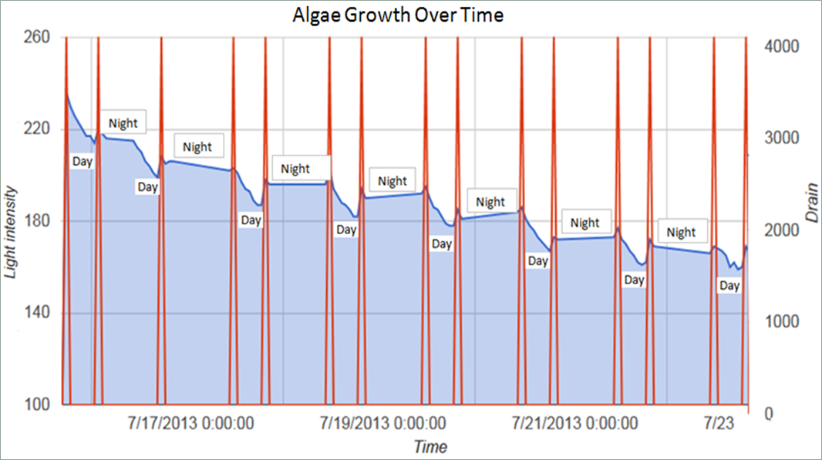
Data Interface

Slide 14
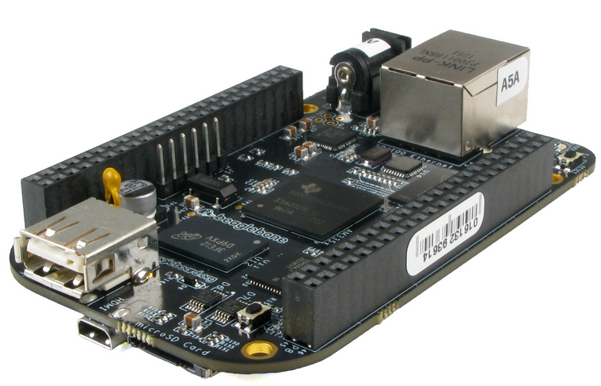
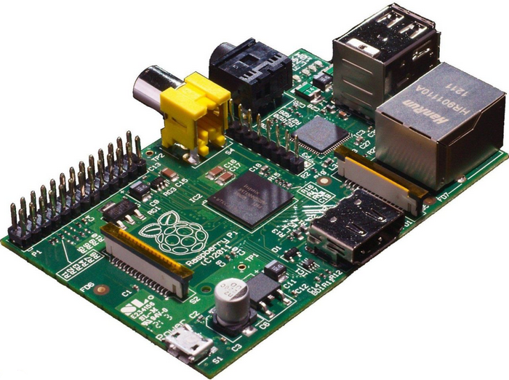
Alternatives
BeagleBone Black
Raspberry Pi

Slide 15
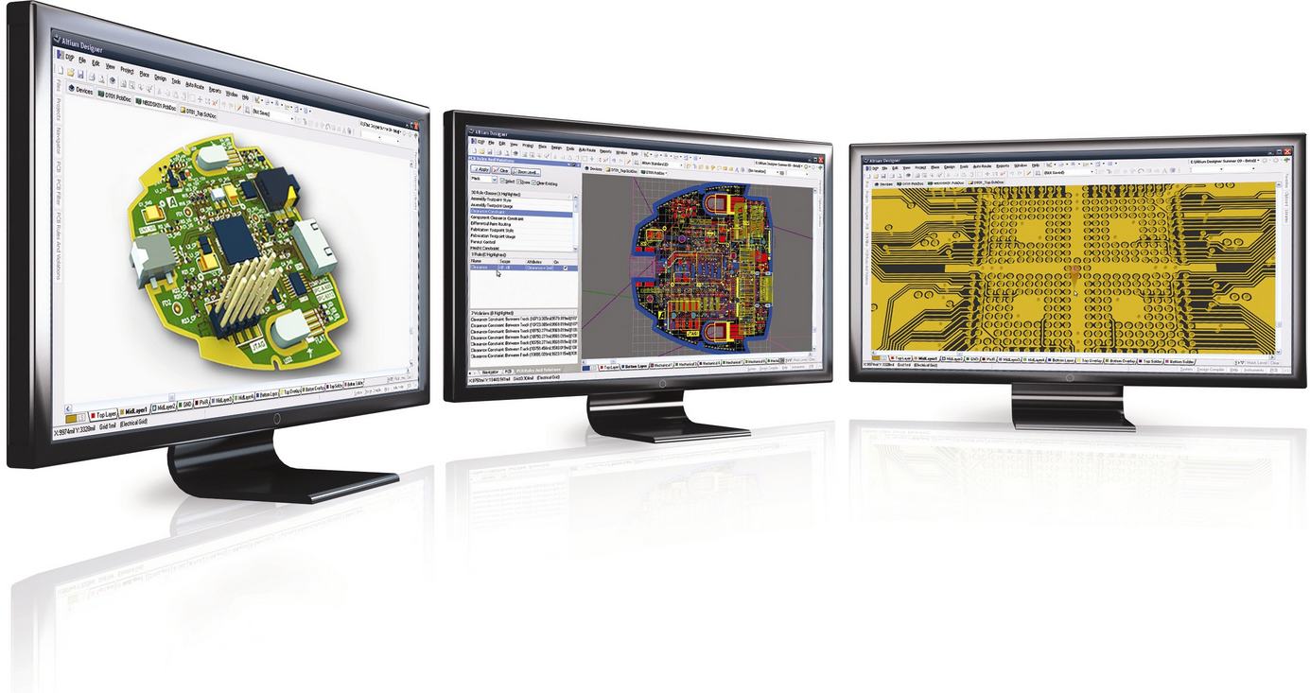
Altium
Electronic Design Automation

Slide 16
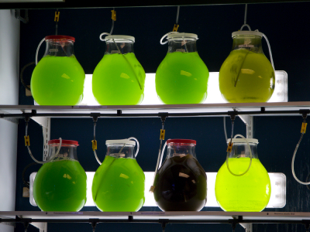
Example

Slide 17
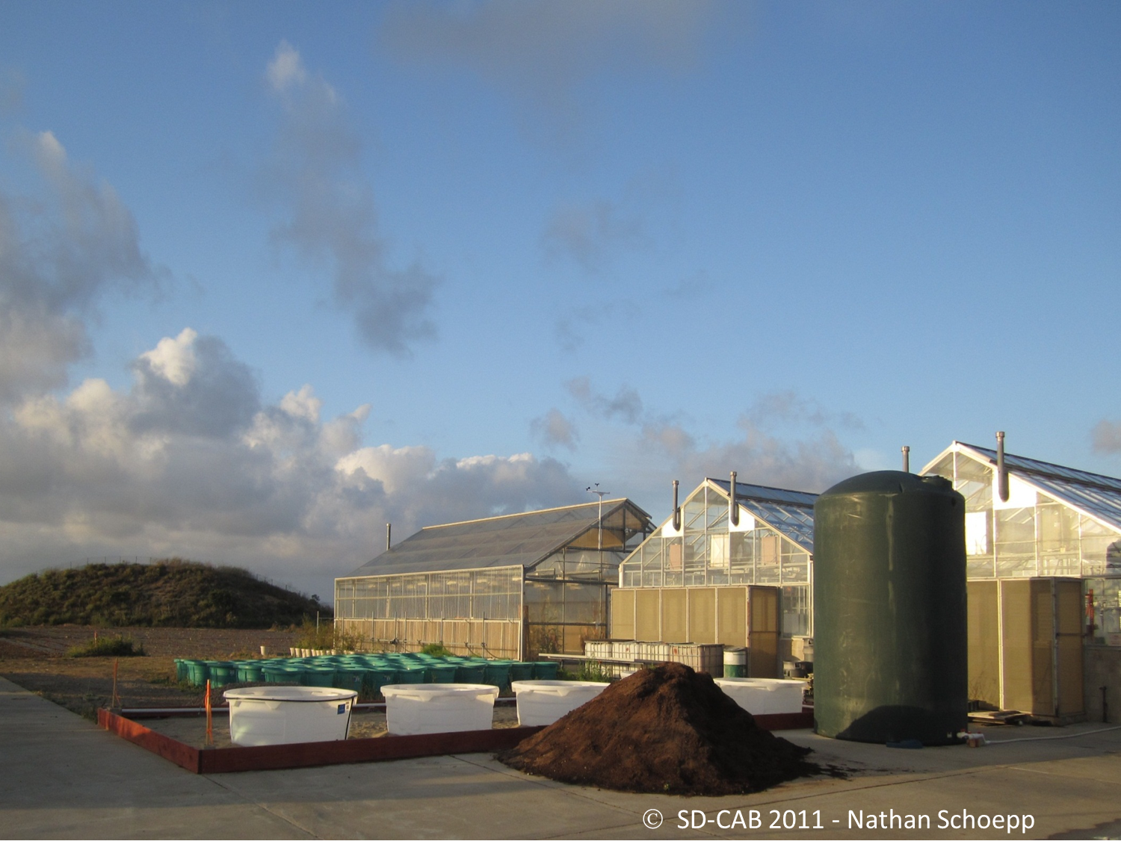
Cal-CAB

Slide 18
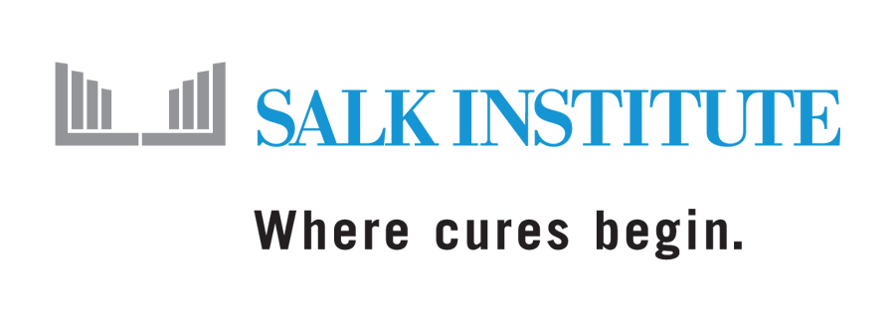

Goals
Client Expansion
Scalable System
User-friendly
Out-Sourced PCB Production

Slide 19
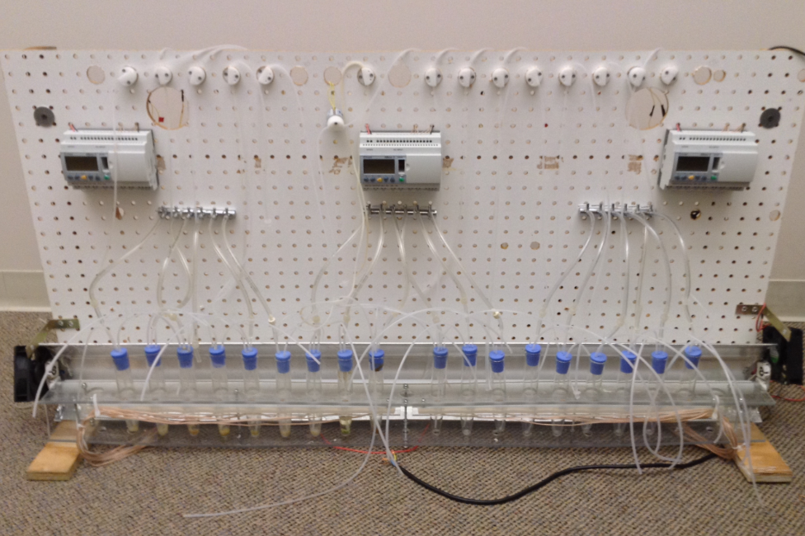

Slide 20
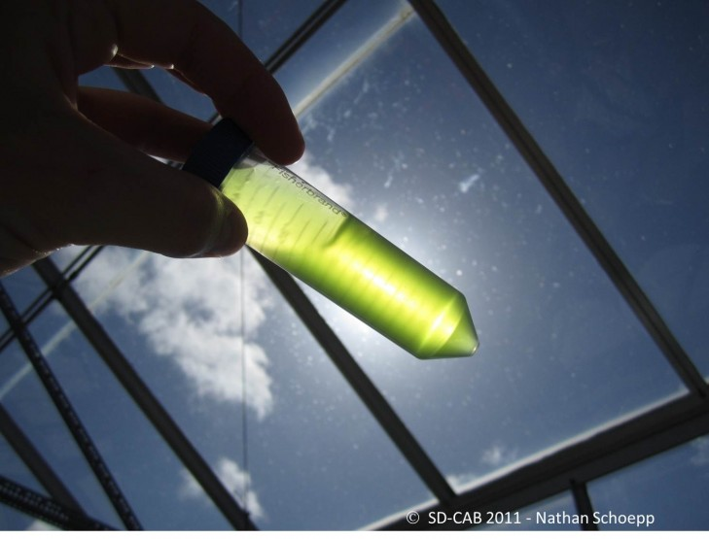

Slide 21
Thank you
Questions/Suggestions?

